Slide 1
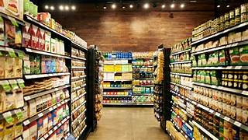
ANALISYS OF SUPERMARKET SALES

Slide 2

INTRODACTION
For my final project, I have chosen to analyze data to identify strategies for improving supermarket sales. The dataset, available on Kaggle, consists of historical sales data covering three months from a supermarket company operating branches in three different cities. This dataset comprises 1,000 rows and 17 columns, providing detailed information about sales transactions, customer demographics, and product performance across different branches.

Slide 3

MACHINE LEARNING

Slide 4
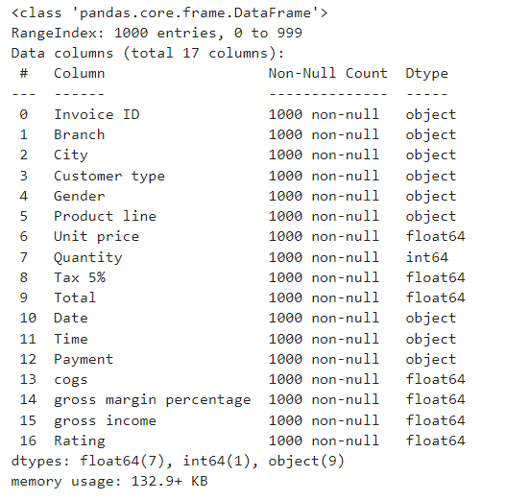

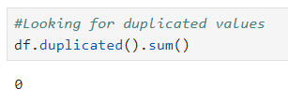
CLEANING DATA
The dataset chosen has no missing (null) values or duplicate rows.

Slide 5
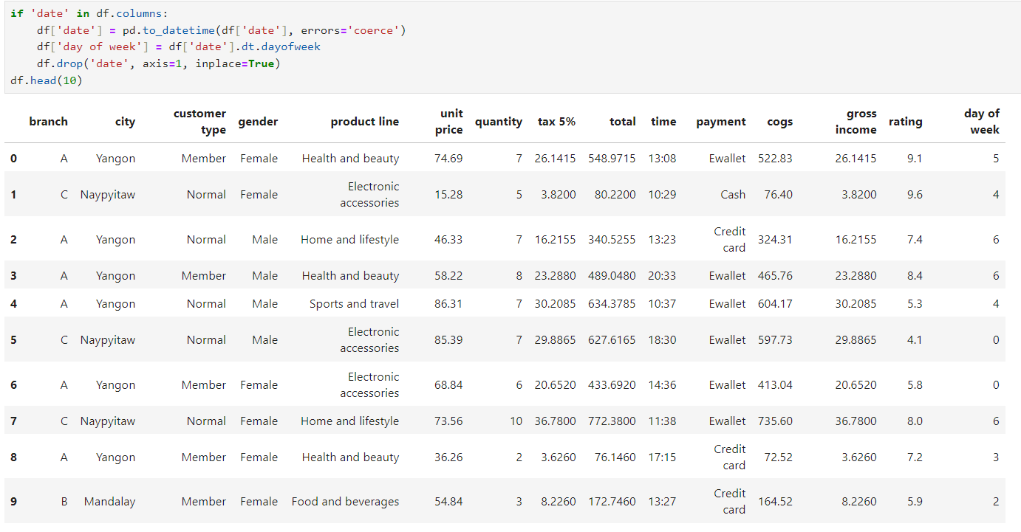

COLUMNS TRANSFORMATION
Regarding the columns, I transformed the « Date » column to display the corresponding day of the week. This helps me analyse transaction patterns by day; identifying which day have higher or lower transaction volumes.

Slide 6
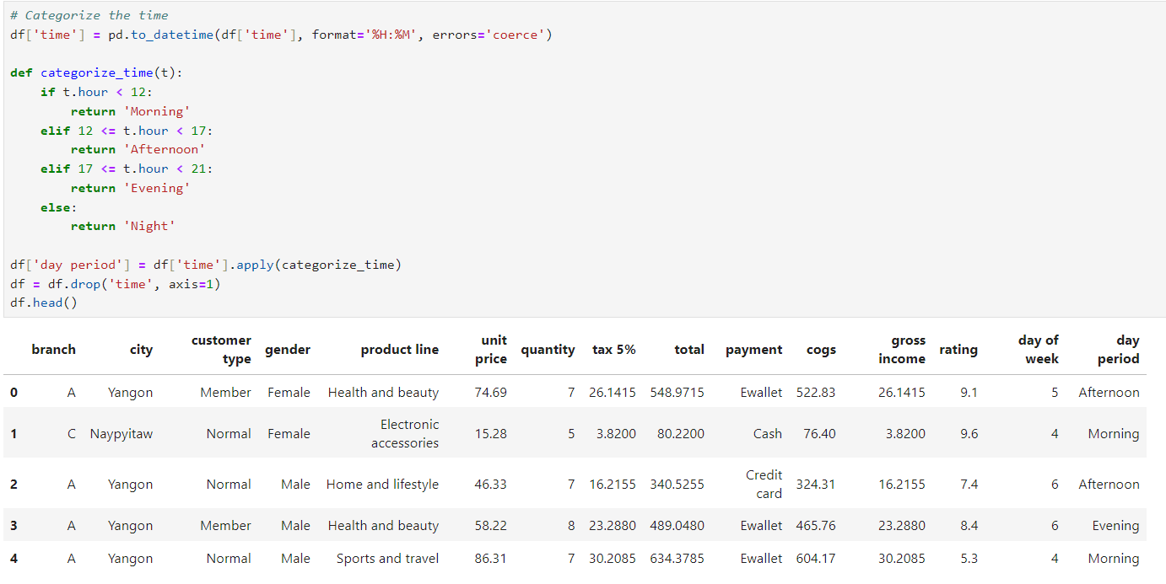
I also converted the « Time » column into period of the day to identify when transaction peak throughout the day. This categorization helps reveal patterns in customer behavior across different times.

Slide 7
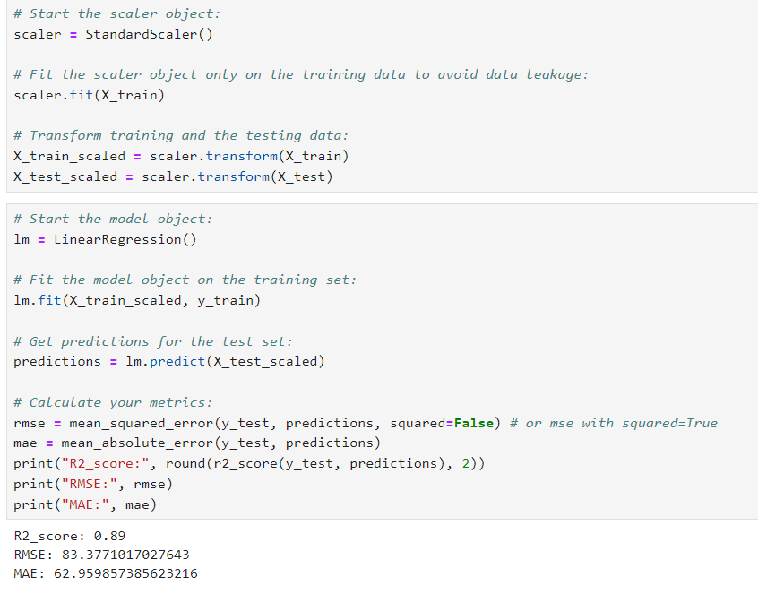
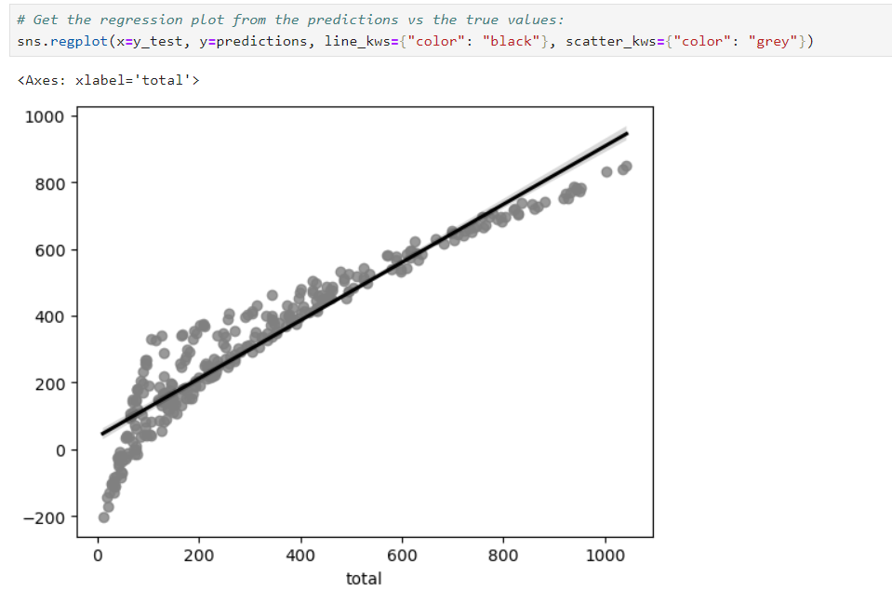
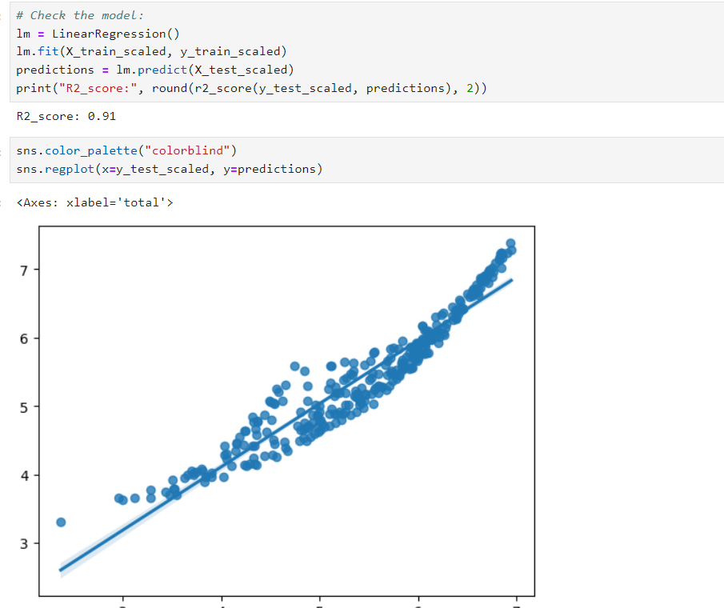

MACHINE LEARNING MODELs. LINEAR REGRESSION.

Slide 8
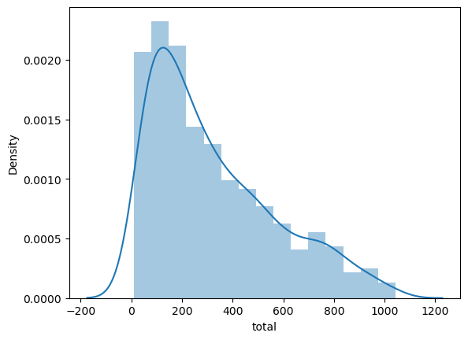
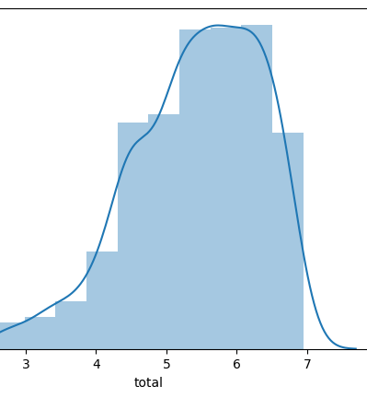
DISTRIBUTION
before log scaling after log scaling.

Slide 9
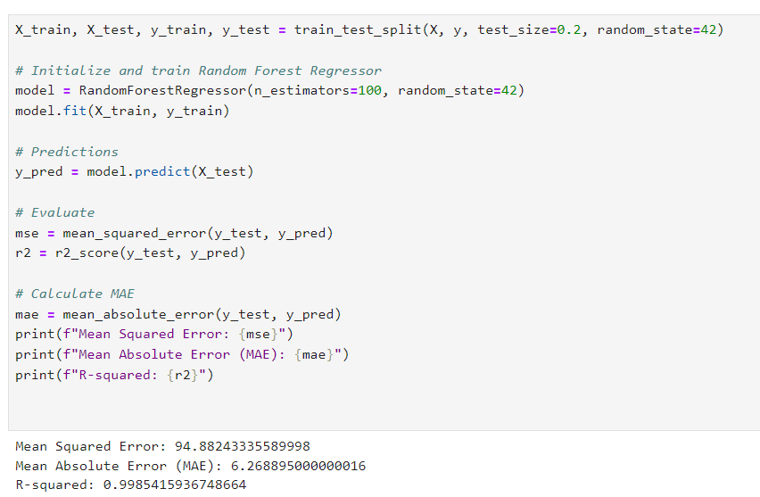
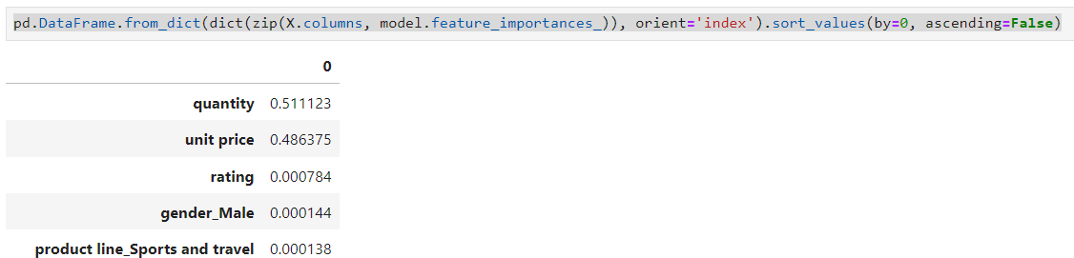
MACHINE LEARNING MODELs. RandomForest Regressor.

Slide 10

DATA VISUALIsATION

Slide 11
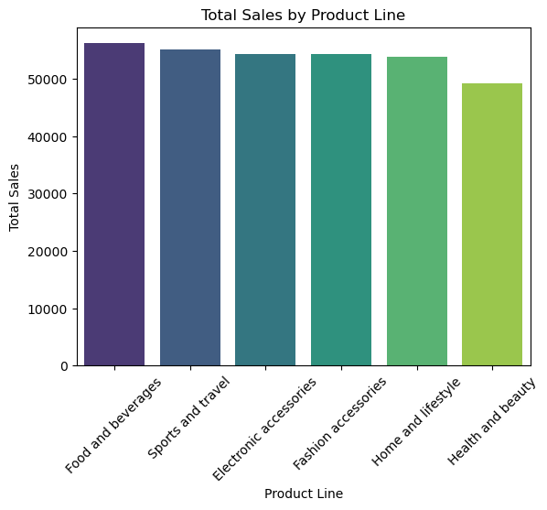
TOTAL SALES BY PRODUCT LINE
PRODUCT LINE | TOTAL ($)
Food and beverages | 56,144.84
Sports and travel | 55,122.83
Electronic accessories | 54,357.53
Fashion accessories | 54,305.89
Home and lifestyle | 53,861.91
Health and beauty | 49,193.74
Food and Beverages has the highest sales. This category is leading in total sales, indicating strong demand.
Fashion Accessories, Electronic Accessories, and Sports and Travel all show relatively similar sales, suggesting steady performance but no significant disparity among them.
Health and Beauty has the lowest sales, which might indicate some challenges in this product line, whether it's lower customer interest or competition from other categories.

Slide 12
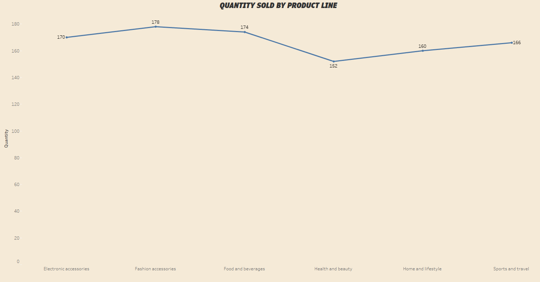
QUANTITY SOLD BY PRODUCT LINE
PRODUCT LINE | QUANTITY SOLD
Fashion accessories | 178
Food and beverages | 174
Electronic accessories | 170
Sports and travel | 166
Home and lifestyle | 160
Health and beauty | 152
Fashion Accessories and Food and Beverages are the highest-selling categories, showing robust demand from customers. These categories likely have broad appeal, making them key areas to focus on for growth.
Electronic Accessories and Sports and Travel show solid performance, but there may be untapped potential for growth here.
Health and Beauty has the lowest quantity sold, which could signal a need for improvement in product offerings, customer engagement, or market visibility.

Slide 13
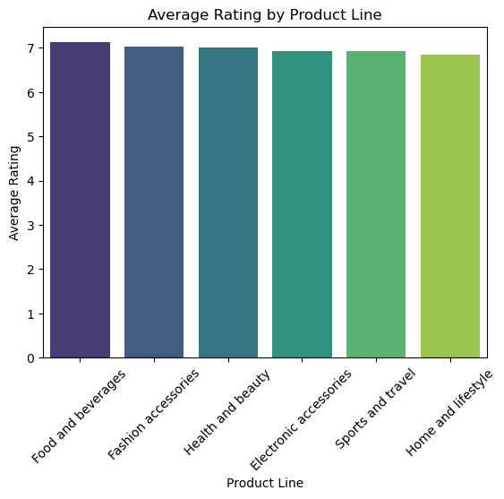
AVERAGE RATING BY PRODUCT LINE
PRODUCT LINE | RATING
Food and beverages | 7.11
Fashion accessories | 7.03
Health and beauty | 7.00
Electronic accessories | 6.92
Sports and travel | 6.92
Home and lifestyle | 6.84
Food and Beverages (7.11) and Fashion Accessories (7.03) have the highest ratings, indicating customer satisfaction in these categories is relatively high.
Home and Lifestyle (6.84), Sports and Travel (6.92), Electronis accessories (6.92), have the lowest ratings, suggesting there may be room for improvement in these categories.

Slide 14
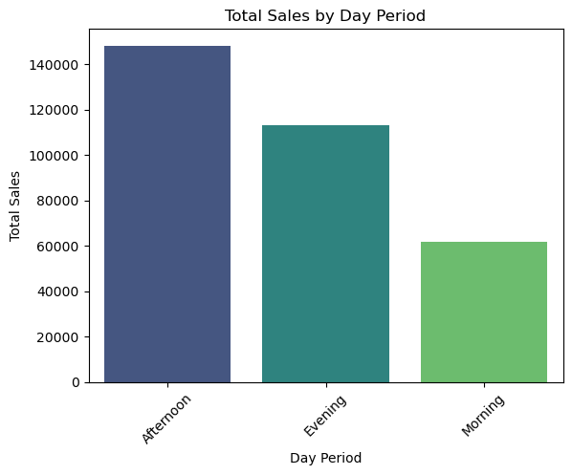
TOTAL SALES BY DAY PERIOD
DAY PERIOD | TOTAL ($)
Afternoon | 148,023.31
Evening | 113,144.63
Morning | 61, 798.88
Afternoon remains the most profitable period, and the Evening follows closely behind, which suggests that customers tend to make purchases later in the day. The Morning sales are significantly lower.
Consider running promotions or offers in the Morning to increase customer flow and sales.
Focus on maintaining or expanding marketing efforts during the Afternoon and Evening, as they are your stronger periods.

Slide 15
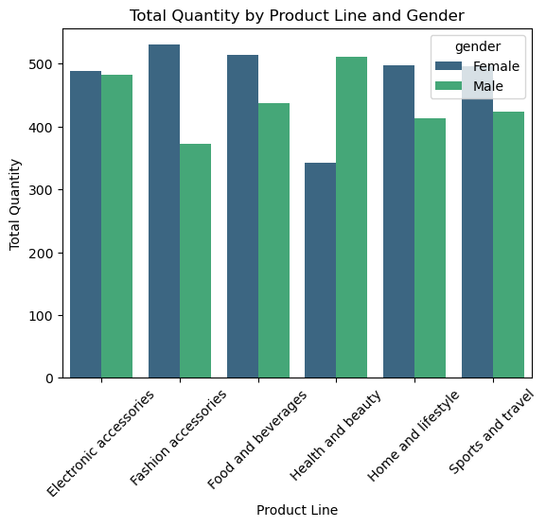
TOTAL QUANTITY BY PRODUCT LINE AND GENDER
The graph shows higher female spending in categories such as Fashion Accessories, Food and Beverages, Home and Lifestyle, and Sport and Travel. These peaks could indicate strong purchasing preferences and habits in these areas.
Male spending exceeds female spending in the Health and Beauty category. This might be due to increased interest in grooming products, fitness supplements, or personal care items.
In the Electronic Accessories category, the graph likely demonstrates a similar expenditure level for both genders.

Slide 16
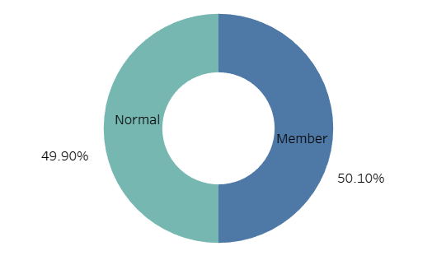
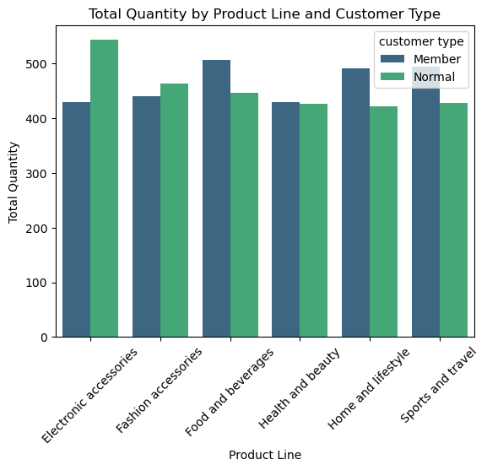
TOTAL QUANTITY BY PRODUCT LINE AND CUSTOMER TYPE
Members spend more in the following categories: Food and Beverage, Home and Lifestyle, Sports and Travel. Higher spending may be due to promotional deals or personalized offers for members.
Non-members are the primary buyers in Electronic Accessories. This category may attract non-members through general promotions or discounts.

Slide 17
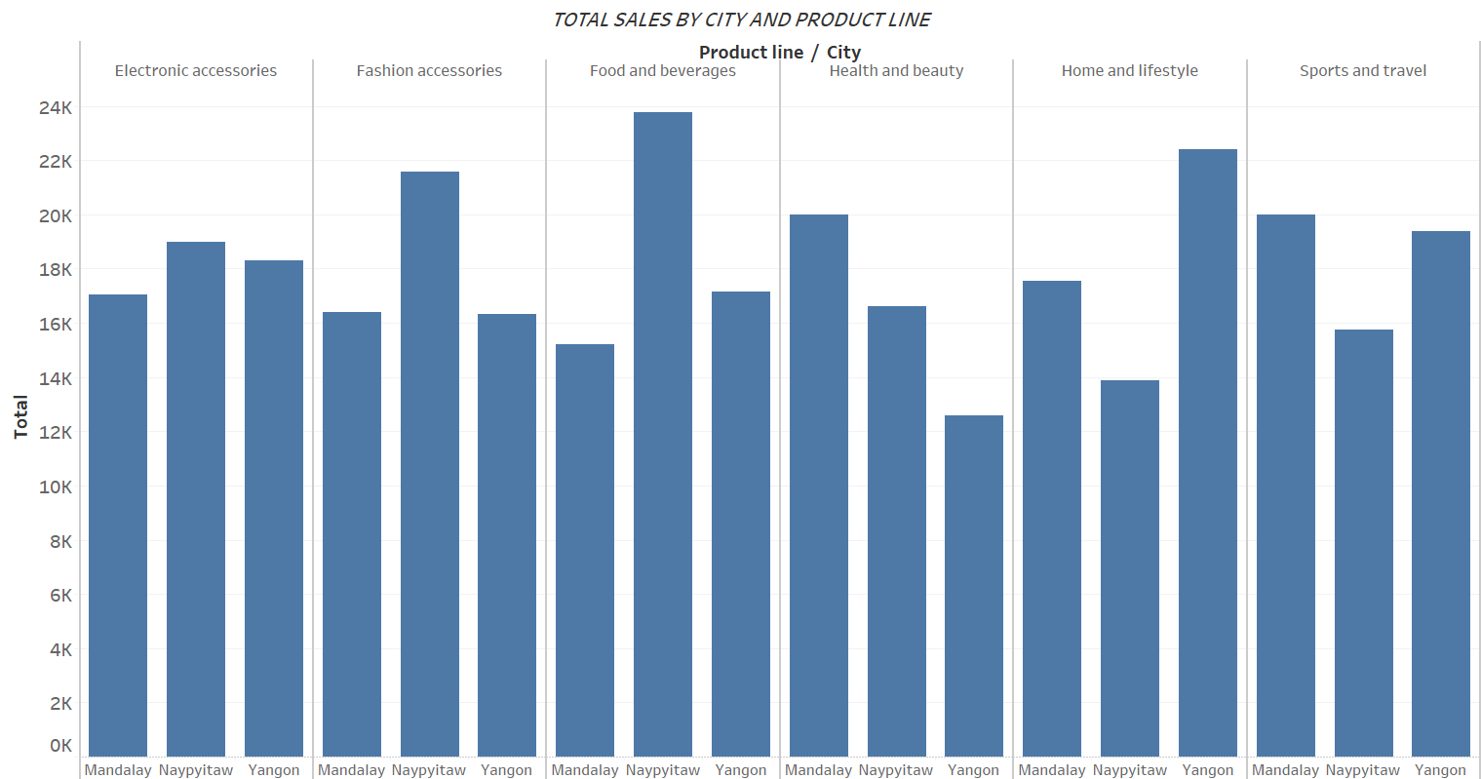
TOTAL SALE BY CITY AND PRODUCT LINE
The graph highlights variations in total sales levels for different product lines across cities. While the lack of demographic, income, and activity data limits the specificity of recommend-dations, there are actionable strategies to optimize sales ba-sed on observed trends:
Seasonal Offers: Align promotions with local holi-days, festivals, or weather-related needs.
City-Specific Campaigns: Identify and emphasize pro-ducts that resonate with the city’s unique culture, lifestyle, or needs.

Slide 18
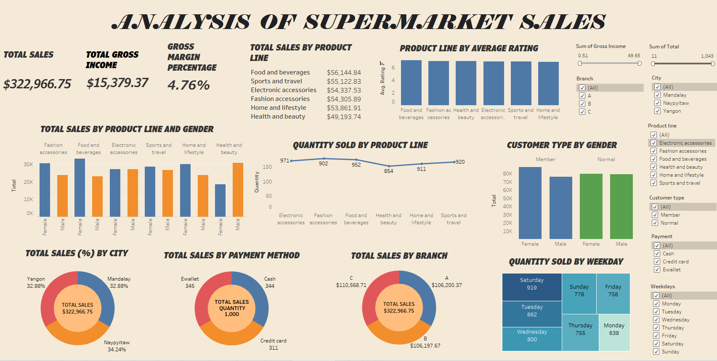

Slide 19
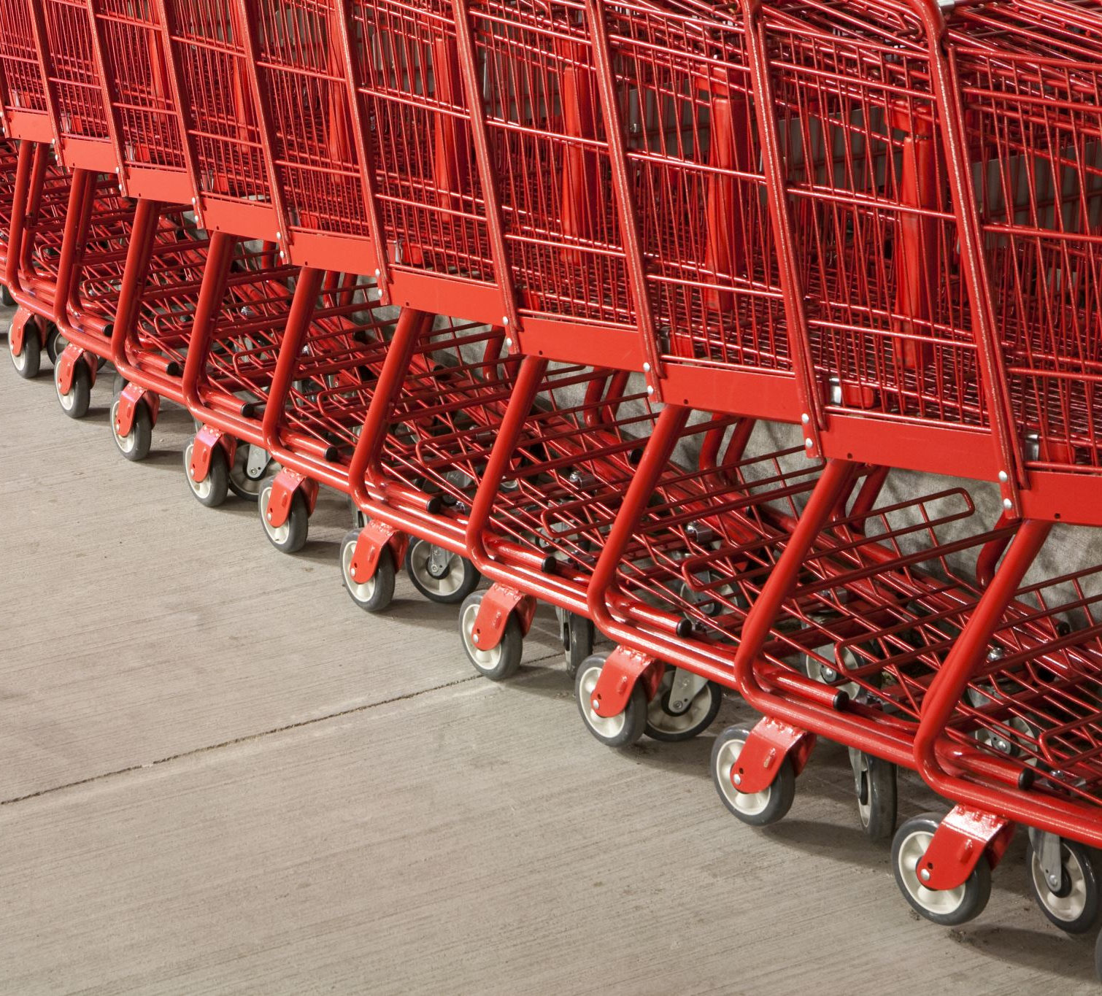
RECOMMENDATIONS
Online Presence: Enhance online visibility and offer delivery options for each product line.
Personalized Offers: Send targeted promotions based on customer preferences.
Customer Feedback: Actively gather and implement feedback to align with customer needs.
Collaborate: Partner with influencers to promote specific product lines through social media campaigns.
Attract Non-Members to Membership Programs: Run limited-time offers where non-members can sample membership benefits.
Cross-Sell Opportunities: Place products near related items (e.g., vitamins with skincare products).
Improve product placement to increase visibility.

Slide 20


